Slide 1
Scheduling
1

Slide 2
Contents
Uniprocessor Scheduling: Types of Scheduling: Preemptive, Non-preemptive, Long-term, Medium-term, Short-term scheduling
Scheduling Algorithms: FCFS, SJF, RR, Priority
Multiprocessor Scheduling: Granularity
Design Issues, Process Scheduling
Deadlock: Principles of deadlock, Deadlock Avoidance
Deadlock Detection, Deadlock Prevention
Deadlock Recovery
2

Slide 3
Uniprocessor (CPU) Scheduling
The problem: Scheduling the usage of a single processor among all the existing processes in the system
The goal is to achieve:
High processor utilization
High throughput
number of processes completed per unit time
Low response time
time elapse from the submission of a request to the beginning of the response
3

Slide 4
Scheduling Objectives
The scheduling function should
Share time fairly among processes
Prevent starvation of a process
Use the processor efficiently
Have low overhead
Prioritise processes when necessary (e.g. real time deadlines)
4

Slide 5
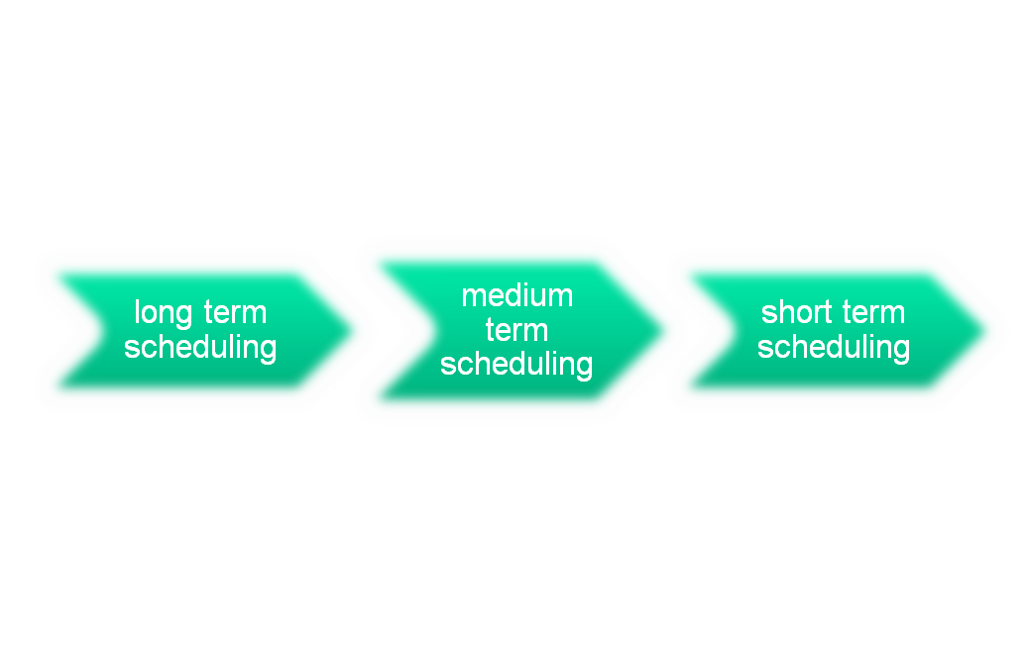
Processor Scheduling
Aim is to assign processes to be executed by the processor in a way that meets system objectives, such as response time, throughput, and processor efficiency
Broken down into three separate functions:
Notes:
The aim of processor scheduling is to assign processes to be executed by the processor
or processors over time, in a way that meets system objectives, such as response
time, throughput, and processor efficiency. In many systems, this scheduling activity
is broken down into three separate functions: long-, medium-, and short-term
scheduling. The names suggest the relative time scales with which these functions are
performed.
5

Slide 6
Types of scheduling
In terms of in which phase is it applicable
Long term scheduling
When a new process is created
Whether to add this to the set of processes who are currently active
Medium term scheduling
Part of swapping function
Whether to add a process to those that are at least partially in main memory and therefore available for execution
Short term scheduling
Actual decision as to which ready process to execute next

Slide 7
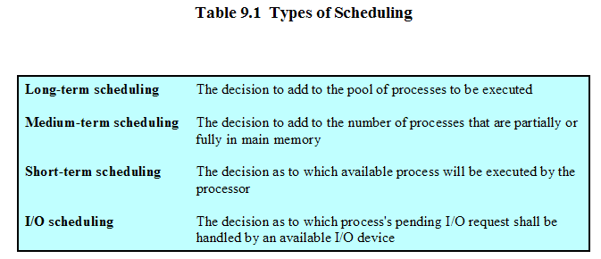
Types of Scheduling
7

Slide 8
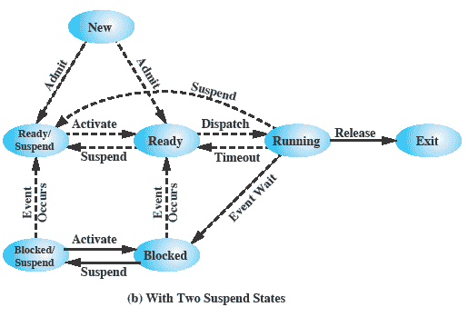
Scheduling and Process State Transitions
8

Slide 9
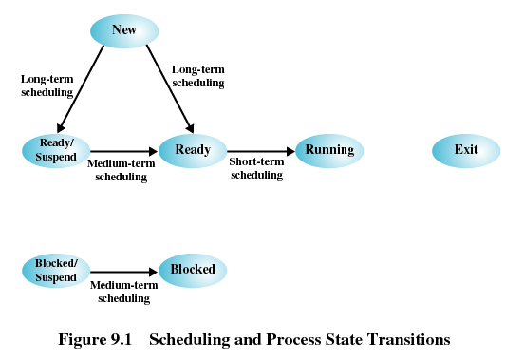
Scheduling and Process State Transitions
9

Slide 10
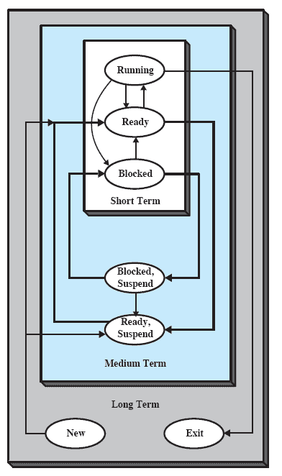
Nesting of Scheduling Functions
10

Slide 11
Another way to look at scheduling
Scheduling determines which process will wait and which will progress
Different queues are involved
Scheduling is a matter of managing queues to minimize queuing delay and to optimize performance in a queuing environment

Slide 12
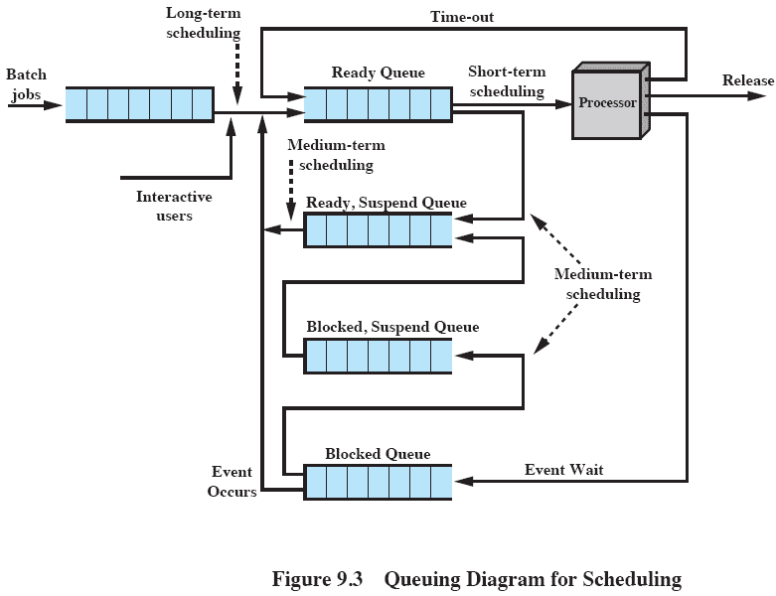
Queuing Diagram for Scheduling
12

Slide 13
Long-Term Scheduling: (Job Scheduler)
Selects which processes should be brought into the ready queue
May be first-come-first-served
Or according to criteria such as priority, I/O requirements or expected execution time
Controls the degree of multiprogramming
If more processes are admitted
less likely that all processes will be blocked
better CPU usage
each process has less fraction of the CPU
The long term scheduler will attempt to keep a mix of processor-bound and I/O-bound processes
13

Slide 14
Two kinds of processes
Processes can be described as either:
I/O-bound process – spends more time doing I/O than computations, many short CPU bursts
Processes that are mostly waiting for the completion of input or output (I/O) are I/O Bound.
Interactive processes, such as office applications are mostly I/O bound the entire life of the process. Some processes may be I/O bound for only a few short periods of time.
The expected short run time of I/O bound processes means that they will not stay the running the process for very long.
They should be given high priority by the scheduler.
CPU-bound process – spends more time doing computations; few very long CPU bursts
CPU Bound processes are ones that are implementing algorithms with a large number of calculations.
They can be expected to hold the CPU for as long as the scheduler will allow.
Programs such as simulations may be CPU bound for most of the life of the process.
Users do not typically expect an immediate response from the computer when running CPU bound programs.
They should be given a lower priority by the scheduler.
14

Slide 15
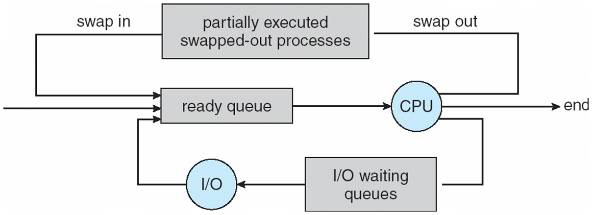
Medium-Term Scheduling (Swapper)
Part of the swapping function
Swapping decisions based on the need to manage multiprogramming
Done by memory management software
15

Slide 16
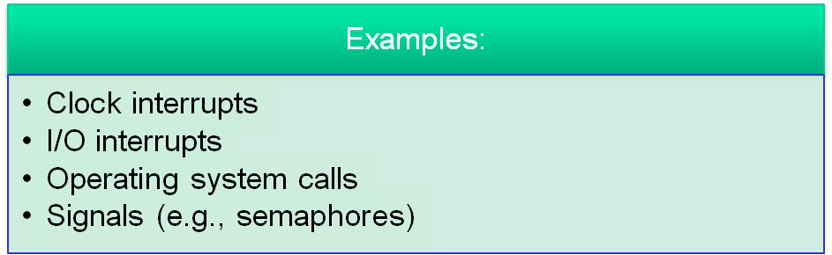
Short-Term Scheduling: (CPU Scheduler)
Selects which process should be executed next and allocates CPU
The short term scheduler is known as the dispatcher
Executes most frequently
Is invoked on a event that may lead to choose another process for execution:
Examples:
16

Slide 17
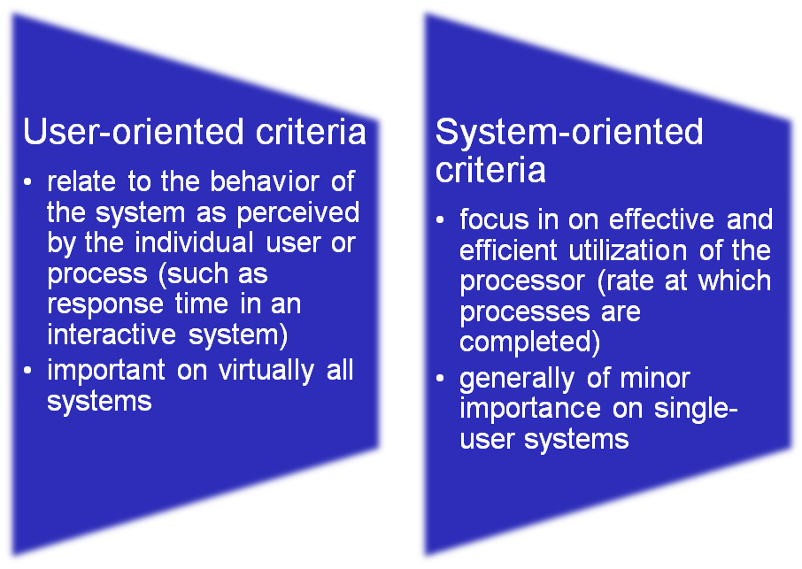
Short Term Scheduling Criteria
Main objective is to allocate processor time to optimize certain aspects of system behaviour
A set of criteria is needed to evaluate the scheduling policy
Notes:
The main objective of short-term scheduling is to allocate processor time in such
a way as to optimize one or more aspects of system behavior. Generally, a set of
criteria is established against which various scheduling policies may be evaluated.
The commonly used criteria can be categorized along two dimensions. First,
we can make a distinction between user-oriented and system-oriented criteria.
User-oriented criteria relate to the behavior of the system as perceived by the
individual user or process. An example is response time in an interactive system.
Response time is the elapsed time between the submission of a request until the
response begins to appear as output. This quantity is visible to the user and is
naturally of interest to the user. We would like a scheduling policy that provides
“good” service to various users. In the case of response time, a threshold may be
defined, say two seconds. Then a goal of the scheduling mechanism should be to
maximize the number of users who experience an average response time of two
seconds or less.
Other criteria are system oriented. That is, the focus is on effective and
efficient utilization of the processor. An example is throughput, which is the rate
at which processes are completed. This is certainly a worthwhile measure of system
performance and one that we would like to maximize. However, it focuses on
system performance rather than service provided to the user. Thus, throughput is of
concern to a system administrator but not to the user population.
Whereas user-oriented criteria are important on virtually all systems, systemoriented
criteria are generally of minor importance on single-user systems. On a
single-user system, it probably is not important to achieve high processor utilization
or high throughput as long as the responsiveness of the system to user applications
is acceptable.
17

Slide 18
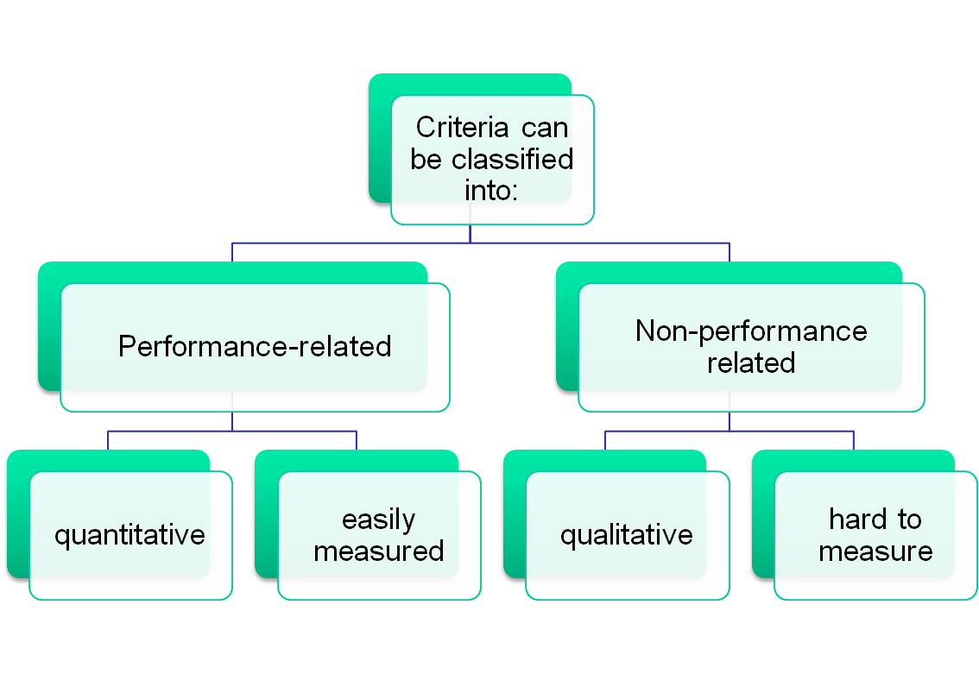
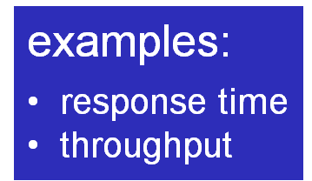
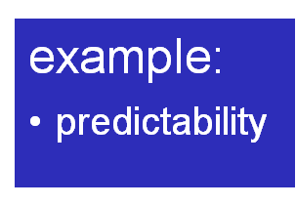
Short-Term Scheduling Criteria: Performance
Notes:
Another dimension along which criteria can be classified is those that
are performance related and those that are not directly performance related.
Performance-related criteria are quantitative and generally can be readily measured.
Examples include response time and throughput. Criteria that are not
performance related are either qualitative in nature or do not lend themselves readily
to measurement and analysis. An example of such a criterion is predictability. We
would like for the service provided to users to exhibit the same characteristics over
time, independent of other work being performed by the system. To some extent,
this criterion can be measured by calculating variances as a function of workload.
However, this is not nearly as straightforward as measuring throughput or response
time as a function of workload.
18

Slide 19
Short-Tem Scheduling Criteria
User-oriented: relate to the behaviour of the system as perceived by the individual user or process
Measure of user satisfaction
Response time in case of interactive systems
Turnaround Time
Important on almost all systems
System-oriented: focused on effective and efficient utilization of the processor.
Measure of system performance
Processor utilization: keep the CPU as busy as possible
Fairness
Throughput: number of process completed per unit time
Waiting time – amount of time a process has been waiting in the ready queue
Not that important on single user systems
19

Slide 20
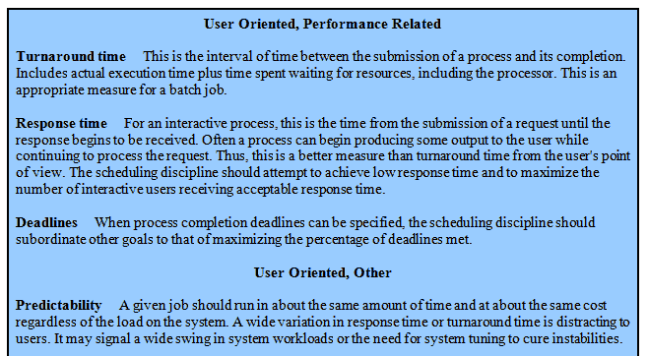
Interdependent Scheduling Criteria
20

Slide 21
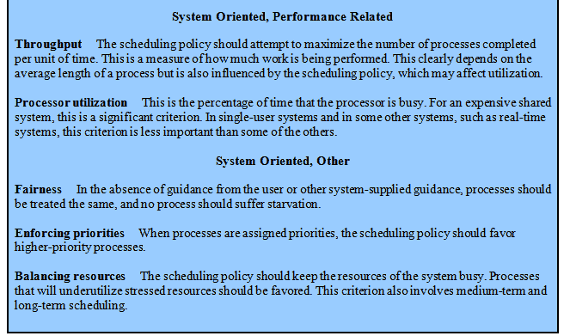
Interdependent Scheduling Criteria
21

Slide 22
Scheduling Algorithm Optimization Criteria
Max CPU utilization
Max throughput
Min turnaround time
Min waiting time
Min response time
22
Notes:
22

Slide 23

Determines which Ready process is dispatched next
May be based on priority, resource requirements, or the execution characteristics of the process
If based on execution characteristics, some factors to consider are
w = time spent in system so far, waiting
e = time spent in execution so far
s = total service time required by the process, including e; (estimated by system or user)
For example, the selection function max[ w ] indicates an FCFS discipline.
Notes:
. The selection function determines which
process, among ready processes, is selected next for execution. The function may
be based on priority, resource requirements, or the execution characteristics of the
process. In the latter case, three quantities are significant:
w = time spent in system so far, waiting
e = time spent in execution so far
s = total service time required by the process, including e ; generally, this quantity
must be estimated or supplied by the user
For example, the selection function max[ w ] indicates an FCFS discipline.
23

Slide 24


When/under what circumstances is the selection function is exercised?
Two categories:
Nonpreemptive
Preemptive
Notes:
The decision mode specifies the instants in time at which the selection function
is exercised. There are two general categories: nonpreemptive and preemptive
24

Slide 25


Nonpreemptive
Preemptive
currently running process may be interrupted and moved to ready state by the OS
preemption may occur when a new process arrives, on an interrupt, or periodically
once a process is in the running state, it will continue until it terminates or blocks itself for I/O
Notes:
Non-preemptive
In this case, once a process is in the Running state, it continues to execute until
it terminates or
it blocks itself to wait for I/O or to request some operating system service.
Preemptive:
The currently running process may be interrupted and moved to the Ready state by the operating system.
The decision to preempt may be performed
when a new process arrives;
when an interrupt occurs that places a blocked process in the Ready state;
or periodically, based on a clock interrupt.
25

Slide 26
Priorities
Scheduler will always choose a process of higher priority over one of lower priority
Have multiple ready queues to represent each level of priority
Lower-priority may suffer starvation
Allow a process to change its priority based on its age or execution history
26

Slide 27
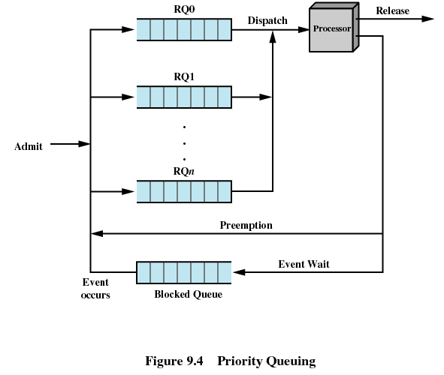
Processes have priorities
27

Slide 28
Contents
Uniprocessor Scheduling: Types of Scheduling: Preemptive, Non-preemptive, Long-term, Medium-term, Short-term scheduling
Scheduling Algorithms: FCFS, SJF, RR, Priority
Multiprocessor Scheduling: Granularity
Design Issues, Process Scheduling
Deadlock: Principles of deadlock, Deadlock Avoidance
Deadlock Detection, Deadlock Prevention
Deadlock Recovery
28

Slide 29

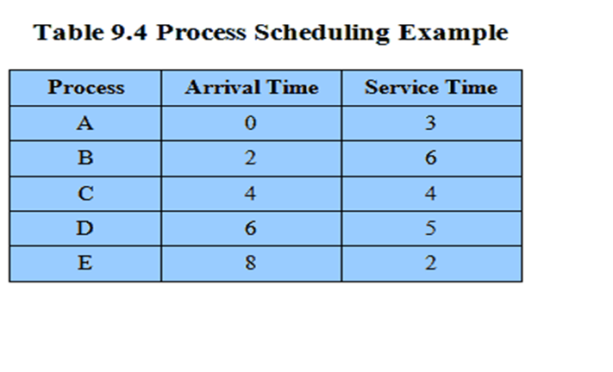
Running example to discuss various scheduling policies
Notes:
As we describe the various scheduling policies, we will use the set of processes
in Table 9.4 as a running example. We can think of these as batch jobs, with the
service time being the total execution time required. Alternatively, we can consider
these to be ongoing processes that require alternate use of the processor and I/O
in a repetitive fashion. In this latter case, the service times represent the processor
time required in one cycle. In either case, in terms of a queuing model, this quantity
corresponds to the service time.
29

Slide 30
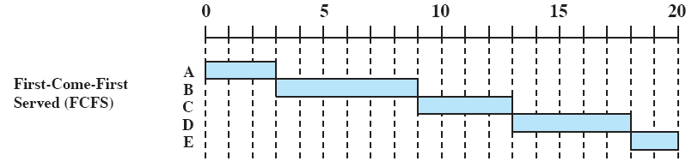
First Come First Served (FCFS)
The simplest scheduling policy is first-come-first-served (FCFS),first-in-first-out (FIFO) or a strict queuing scheme.
As each process becomes ready, it joins the ready queue.
When the currently running process ceases to execute, the process that has been in the ready queue the longest is selected for running.
Selection function: the process that has been waiting the longest in the ready queue (hence, FCFS)
Decision mode: nonpreemptive, a process runs until it blocks itself
30

Slide 31
FCFS Drawbacks
A short process may have to wait a very long time before it can execute.
A process that does not perform any I/O will monopolize the processor.
Favours CPU-bound processes
I/O-bound processes have to wait until CPU-bound process completes
They may have to wait even when their I/O are completed (poor device utilization)
we could have kept the I/O devices busy by giving more priority to I/O Bound processes.
31

Slide 32
FCFS Drawbacks
FCFS is not an attractive alternative on its own for a Uniprocessor system.
However, it is often combined with a priority scheme to provide an effective scheduler.
Thus, the scheduler may maintain a number of queues, one for each priority level, and dispatch within each queue on a first-come-first-served basis.

Slide 33
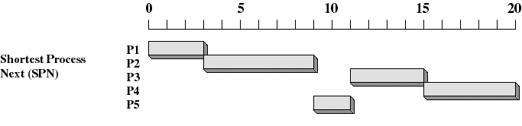
Shortest Process Next (SPN) (SJF-Nonpreemptive)
Selection function: the process with the shortest expected CPU burst time
Decision mode: nonpreemptive
I/O bound processes will be picked first
We need to estimate the required processing time (CPU burst time) for each process
Average waiting time will be minimum.
33

Slide 34
Shortest Process Next: Critique
Average waiting time will be minimum.
Although it is optimal ,can not be implemented at the level of short term CPU scheduling
As there is no way to know the length of the next cpu burst time.

Slide 35
Shortest Process Next: Critique
Possibility of starvation for longer processes as long as there is a steady supply of shorter processes
Lack of pre-emption is not suited in a time sharing environment
CPU bound process gets lower priority (as it should) but a process doing no I/O could still monopolize the CPU if it is the first one to enter the system
SPN implicitly incorporates priorities: shortest jobs are given preferences
The next (pre-emptive) algorithm penalizes directly longer jobs
35

Slide 36
Shortest Process Next: Critique
Average waiting time will be minimum
FCFS is used to break the tie if two processes have same burst time
SJF is a special case of general priority scheduling
Priority is the inverse of the next cpu burst
Larger the cpu burst, lower the priority & vice versa.

Slide 37
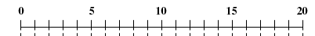
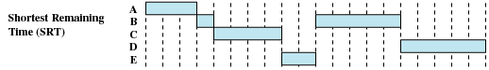
Shortest Remaining Time(SJF-Pre-emptive)
Pre-emptive version of shortest process next policy
Must estimate processing time
37

Slide 38
SRT / SJF P
Estimate of remaining time required here as well
Risk of starvation of longer processes
No bias in favor of long processes as with FCFS
No additional interrupts are generated unlike RR thereby reducing overhead
But elapsed service times must be recorded, increasing the overhead
Short job is given preference over running longer job, thus better turn around time

Slide 39
Priority Scheduling
A priority number (integer) is associated with each process.
The CPU is allocated to the process with the highest priority
Some systems have a high number represent high priority.
Other systems have a low number represent high priority.
Text uses a low number to represent high priority.
Priority scheduling may be preemptive or nonpreemptive.

Slide 40
Assigning Priorities
SJF is a priority scheduling where priority is the predicted next CPU burst time.
Other bases for assigning priority:
Memory requirements
Number of open files
Avg I/O burst / Avg CPU burst
External requirements (amount of money paid, political factors, etc).
Range of priority 0 to 7 or 0 to 4095
Priorities can be defined either internally or externally
Internal priority: time limit, no. of open files
External priority: set by criteria outside the os e.g. imp of processes
Problem: Starvation -- low priority processes may never execute.
Solution: Aging -- as time progresses increase the priority of the process.

Slide 41
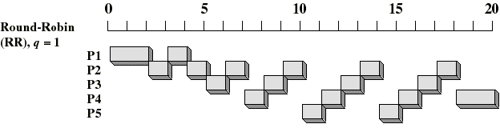
Round-Robin
Selection function: same as FCFS
Decision mode: preemptive
a process is allowed to run until the time slice period (quantum, typically from 10 to 100 ms) has expired
then a clock interrupt occurs and the running process is put on the ready queue
41

Slide 42
Round-Robin
Clock interrupt is generated at periodic intervals
When an interrupt occurs, the currently running process is placed in the ready queue
Next ready job is selected.
The principal design issue is the length of the time quantum, or slice, to be used.
If the quantum is very short, then short processes will move through the system relatively quickly.
BUT there is processing over-head involved in handling the clock interrupt and performing the scheduling and dispatching function.
Thus, very short time quantum should be avoided.

Slide 43
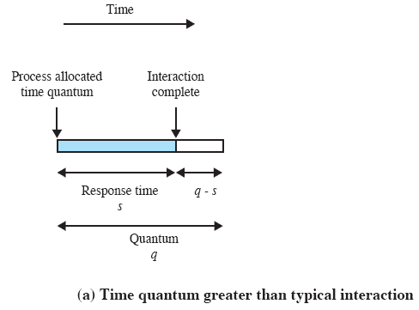

Effect of Size of Preemption Time Quantum
One useful guide is that the time quantum should be slightly greater than the time required for
a typical interaction or process function. If it is less, then most processes will require at least two time quanta.
Notes:
One useful guide is that the time quantum should be slightly greater than the time required for
a typical interaction or process function. If it is less, then most processes will require
at least two time quanta. Figure 9.6 illustrates the effect this has on response time.
Note that in the limiting case of a time quantum that is longer than the longest running
process, round robin degenerates to FCFS.
43

Slide 44
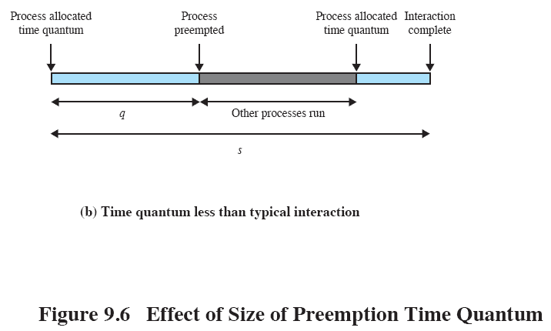
Effect of Size of Preemption Time Quantum
Notes:
Figure 9.6 continued.
Effect of size of preemption time quantum.
44

Slide 45
Time Quantum for Round Robin
Must be substantially larger than the time required to handle the clock interrupt and dispatching
Should be larger than the typical interaction (but not much more to avoid penalizing I/O bound processes)
45

Slide 46
Round Robin: Critique
Still favours CPU-bound processes
A I/O bound process uses the CPU for a time less than the time quantum, then is blocked waiting for I/O
A CPU-bound process runs for all its time slice and is put back into the ready queue (thus, getting in front of blocked processes)
46

Slide 47
Virtual Round Robin
A solution: virtual round robin
When a I/O has completed, the blocked process is moved to an auxiliary queue, which gets preference over the main ready queue
A process dispatched from the auxiliary queue runs no longer than the basic time quantum minus the time spent running, since it was selected from the ready queue
Performance studies indicate that this performs better than regular RR

Slide 48
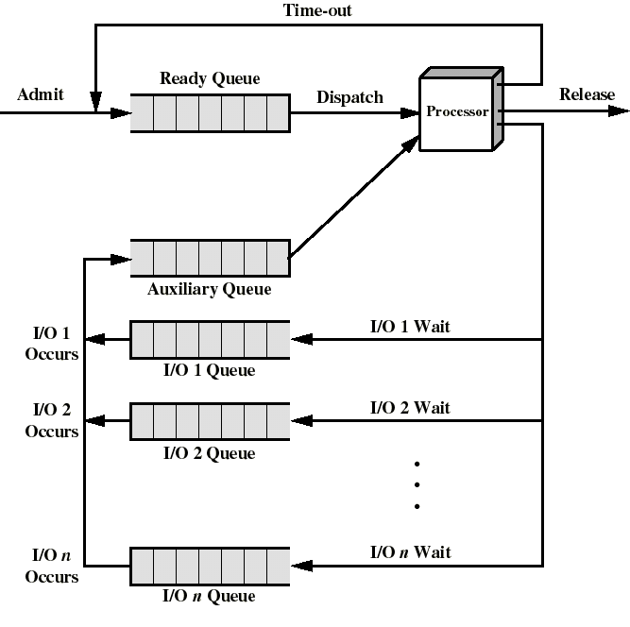
Queuing for Virtual Round Robin
48

Slide 49
Determines which Ready process is dispatched next
May be based on priority, resource requirements, or the execution characteristics of the process
If based on execution characteristics, some factors to consider are
w = time spent in system so far, waiting
e = time spent in execution so far
s = total service time required by the process, including e; (estimated by system or user)
Notes:
. The selection function determines which
process, among ready processes, is selected next for execution. The function may
be based on priority, resource requirements, or the execution characteristics of the
process. In the latter case, three quantities are significant:
w = time spent in system so far, waiting
e = time spent in execution so far
s = total service time required by the process, including e ; generally, this quantity
must be estimated or supplied by the user
For example, the selection function max[ w ] indicates an FCFS discipline.
49

Slide 50
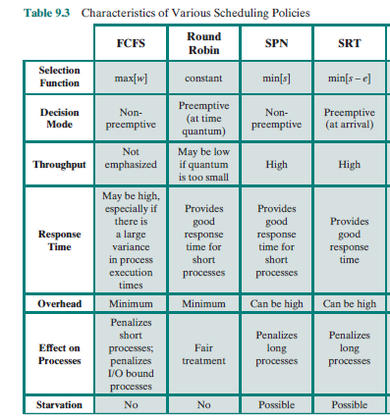

Slide 51
First-Come, First-Served (FCFS) Scheduling
Process that requests the CPU first is allocated the CPU first.
Easily managed with a FIFO queue.
Often the average waiting time is long.
Process Burst Time
P₁ 24
P₂ 3
P₃ 3
Suppose that the processes arrive in the order: P₁ , P₂ , P₃ The Gantt Chart for the schedule is:
P₁
P₂
P₃
0
24
27
30

Slide 52
Suppose that the processes arrive in the order
P₂ , P₃ , P₁ .
The Gantt chart for the schedule is:
P₂
P₃
P₁
0
3
6
30

Slide 53
Example of Non-Preemptive SJF
Process Arrival Time Burst Time
P₁ 0.0 7
P₂ 2.0 4
P₃ 4.0 1
P₄ 5.0 4
SJF (non-preemptive)
P₁
P₃
P₂
P₄
0
3
7
8
12
16

Slide 54
Example of Preemptive SJF
Process Arrival Time Burst Time
P₁ 0.0 7
P₂ 2.0 4
P₃ 4.0 1
P₄ 5.0 4
P₁
P₂
P₃
P₂
P₄
P₁
0
2
4
5
7
11
16

Slide 55
Practice
Process | Arrival Time | Burst Time | Priority
A | 0 | 1 | 3
B | 1 | 9 | 3
C | 3 | 1 | 2
D | 3 | 9 | 1
Draw Gantt Chart to find finish times and also calculate TT and WT in case of each of the following strategies:
FCFS
SJF Non Preemptive
SJF Preemptive
Round Robin
Priority Non preemptive

Slide 56
Contents
Uniprocessor Scheduling: Types of Scheduling: Preemptive, Non-preemptive, Long-term, Medium-term,
Short-term scheduling
Scheduling Algorithms: FCFS, SJF, RR, Priority
Multiprocessor Scheduling: Granularity
Design Issues, Process Scheduling
Deadlock: Principles of deadlock, Deadlock Avoidance
Deadlock Detection, Deadlock Prevention
Deadlock Recovery
56

Slide 57
Multiprocessor Scheduling

Slide 58
Introduction
When a computer system contains more than a single processor, several new issues are introduced into the design of scheduling functions.
We will examine these issues and the details of scheduling algorithms for tightly coupled multi-processor systems.

Slide 59
Classifications of Multiprocessor Systems
1. Loosely coupled, distributed multiprocessors, or clusters
Fairly autonomous systems.
Each processor has its own memory and I/O channels
2. Functionally specialized processors
Typically, specialized processors are controlled by a master( general-purpose processor) and provide services to it. An example would be an I/O processor, graphics processor
3. Tightly coupled multiprocessing
Consists of a set of processors that share a common main memory and are under the integrated control of an operating system.
We’ll be most concerned with this group.
Notes:
We can classify multiprocessor systems as follows:
• Loosely coupled or distributed multiprocessor, or cluster:
Consists of a collection of relatively autonomous systems, each processor having its own main memory and I/O channels.
• Functionally specialized processors:
An example is an I/O processor.
In this case, there is a master, general-purpose processor; specialized processors are controlled by the master processor and provide services to it.
• Tightly coupled multiprocessing:
Consists of a set of processors that share a common main memory and are under the integrated control of an operating system.
59

Slide 60
Multiprocessor Systems
Interconnection Network
P
P
P
Memory
Memory
Memory
Interconnection Network
P
P
P
P
P
P
Memory
Memory
Memory
Global Shared Memory
Interconnection Network
disk
disk
disk
disk
disk
disk
disk
disk
disk
Shared Nothing
(Loosely Coupled)
Shared Memory
(Tightly Coupled)
Shared Disk

Slide 61
Parallel computing
Parallel computing is a form of computation in which many calculations are carried out simultaneously, operating on the principle that large problems can often be divided into smaller ones, which are then solved concurrently ("in parallel").
There are several different forms of parallel computing: bit-level, instruction level, data, and task parallelism.
Task parallelisms is the characteristic of a parallel program that "entirely different calculations can be performed on either the same or different sets of data“.
Task parallelism involves the decomposition of a task into sub-tasks and then allocating each sub-task to a processor for execution. The processors would then execute these sub-tasks simultaneously and often cooperatively.

Slide 62
Granularity
A good metric for characterizing multiprocessors and placing them in context with other architectures is to consider the synchronization granularity,
Or frequency of synchronization, between processes in a system.
Five categories, differing in granularity:
1. Independent Parallelism
2. Coarse Parallelism
3. Very Coarse-Grained Parallelism
4. Medium-Grained Parallelism
5. Fine-Grained Parallelism

Slide 63
Independent Parallelism
No explicit synchronization among processes
Each represents a separate, independent application or job.
Multiple unrelated processes
For e.g. in time sharing system
Each user is performing a particular application such as word processor or spreadsheet
The multiprocessor provides the same service as a multiprogrammed uniprocessor.
Only difference is that since more processors are there, avg response time to the user will be less
As if each user is on a separate machine, as good as a distributed system – still multi processor is more cost effective
Synchronization interval (instruction) :N/A

Slide 64
Coarse and Very Coarse-Grained Parallelism
Synchronization among processes is there but at a very gross level.
It is a set of concurrent processes running on a multi-programmed uni-processor and can be supported on a multiprocessor with little or no change to user software.
In general, any collection of concurrent processes that need to communicate or synchronize can benefit from the use of a multiprocessor architecture.
In the case of very infrequent interaction among the processes, a distributed system can provide good support.
However, if the interaction is somewhat more frequent, then the overhead of communication across the network may negate some of the potential speedup. In that case, the multiprocessor organization provides the most effective support.

Slide 65
Medium-Grained Parallelism
A single application can be effectively implemented as a collection of threads within a single process.
In this case, the programmer must explicitly specify the potential parallelism of an application.
Threads usually interact frequently, affecting the performance of the entire application
Synchronization interval (instruction) :20 -200

Slide 66
Fine Grained Parallelism
Highly parallel applications:
Fine-grained parallelism represents a much more complex use of parallelism than is found in the use of threads.
Synchronization interval (instruction)< 20

Slide 67
Parallelism
Applications are often classified according to how often their subtasks need to synchronize or communicate with each other.
An application exhibits fine-grained parallelism if its subtasks must communicate many times per second;
It exhibits coarse-grained parallelism if they do not communicate many times per second,
And it is embarrassingly parallel if they rarely or never have to communicate. Embarrassingly parallel applications are considered the easiest to parallelize.

Slide 68
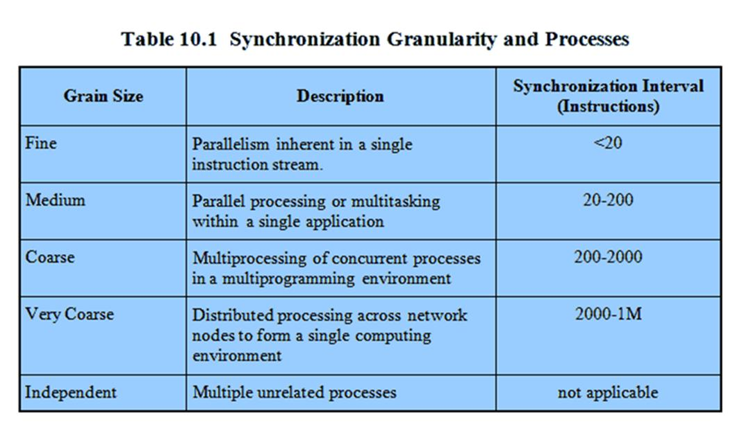
Synchronization Granularity and Processes
Notes:
68

Slide 69
Design Issues
Scheduling on a multiprocessor involves three interrelated issues:
Assignment of processes to processors.
Use of multiprogramming on individual processors.
Actual dispatching of a process.

Slide 70
Assignment of processes to processors
If we assume that the architecture of the multiprocessor is uniform, in the sense that no processor has a particular physical advantage with respect to access to main memory or I/O devices, then the simplest scheduling protocol is to treat processors as a pooled resource and assign processes to processors on demand.
The question then arises as to whether the assignment should be static or dynamic?

Slide 71
Assignment of processes to processors
If a process is permanently assigned (static assignment) to a processor from activation until completion, then a dedicated short-term queue is maintained for each processor.
Allows for group or gang scheduling (details later).
Advantage: less overhead – processor assignment occurs only once.
Disadvantage: One processor could be idle (has an empty queue) while another processor has a backlog. To prevent this situation from arising, a common queue can be utilized. In this case, all processes go into one global queue and are scheduled to any available processor. Thus, over the life of a process, it may be executed on several different processors at different times.
Dynamic load balancing in linux,thread moves from queue of one processor to queue of another processor.

Slide 72
Assignment of processes to processors
Regardless of whether processes are dedicated to processors, some mechanism is needed to assign processes to processors.
Two approaches have been used: master/slave and peer.
Master/slave architecture
Key kernel functions always run on a particular processor. The other processors can only execute user programs.
Master is responsible for scheduling jobs.
Slave sends service request to the master.
Advantages
Simple, requires little enhancement to a uniprocessor multiprogramming OS.
Conflict resolution is simple since one processor has control of all memory and I/O resources.
Disadvantages
Failure of the master brings down whole system
Master can become a performance bottleneck
Notes:
72

Slide 73
Assignment of processes to processors
2. Peer architecture
The OS kernel can execute on any processor.
Each processor does self-scheduling from the pool of available processes.
Advantages:
All processors are equivalent.
No one processor should become a bottleneck in the system.
Disadvantage:
Complicates the operating system
The OS must make sure that two processors do not choose the same process and that the processes are not somehow lost from the queue.
Techniques must be employed to resolve and synchronize competing claims for resources.
Notes:
The kernel can execute on any processor,
and each processor does self-scheduling from the pool of available processes.
This approach complicates the operating system.
The operating system must ensure that two processors do not choose the same process and that the processes are not somehow lost from the queue.
Techniques must be employed to resolve and synchronize competing claims to resources.
73

Slide 74
Multiprogramming at each processor
After static allocation of process to the processor, should that processor be multiprogrammed?
Completion time and other application-related performance metrics are much more important than processor utilization in multi-processor environment.
For example, a multi-threaded application may require all its threads be assigned to different processors for good performance.
Static or dynamic allocation of processes.

Slide 75
Process dispatching
After assignment, deciding who is selected from among the pool of waiting processes --- process dispatching.
Single processor multiprogramming strategies may be counter-productive here.
Priorities and process history may not be sufficient.

Slide 76
Process scheduling
Single queue of processes or if multiple priority is used, multiple priority queues, all feeding into a common pool of processors.
Specific scheduling policy does not have much effect as the processor number increases.
Conclusion: Use FCFS with priority levels.

Slide 77
Contents
Uniprocessor Scheduling: Types of Scheduling: Preemptive, Non-preemptive, Long-term, Medium-term,
Short-term scheduling
Scheduling Algorithms: FCFS, SJF, RR, Priority
Multiprocessor Scheduling: Granularity
Design Issues, Process Scheduling
Deadlock: Principles of deadlock, Deadlock Prevention
Deadlock Avoidance (Operating system concepts by Galvin ,Gagne)
Deadlock Detection, Deadlock Recovery
77

Slide 78

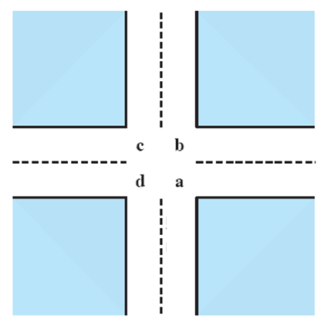
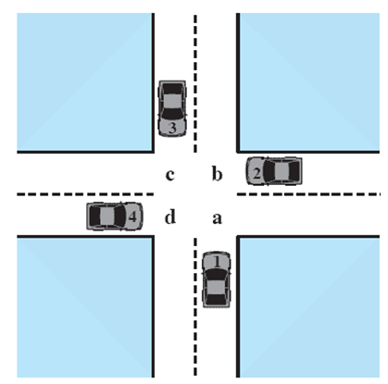



Potential Deadlock
I need quad C and B
I need quad B and C
I need quad A and B
I need quad D and A
Notes:
Animated Slide
Click 1 Cars approach intersection
Then Cars announce their resource needs
All deadlocks involve conflicting needs for resources by two or more processes. A common example is the traffic deadlock.
The typical rule of the road in the United States is that a car at a four-way stop should defer to a car immediately to its right.
This rule works if there are only two or three cars at the intersection.
If all four cars arrive at about the same time, each will refrain from entering the intersection, this causes a potential deadlock.
The deadlock is only potential, not actual, because the necessary resources are available for any of the cars to proceed.
If one car eventually does proceed, it can do so.
78

Slide 79
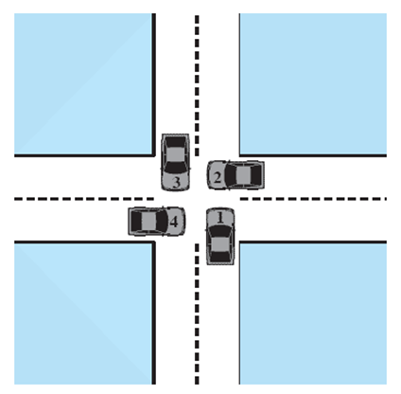
Actual Deadlock
HALT until D is free
HALT until C is free
HALT until B is free
HALT until A is free
Notes:
Animated Slide
Click 1 Cars move to deadlock
Then Cars announce their resource need
But if all four cars ignore the rules and proceed (cautiously) into the intersection at the same time, then each car seizes one resource (one quadrant) but cannot proceed because the required second resource has already been seized by another car.
This is an actual deadlock.
79

Slide 80
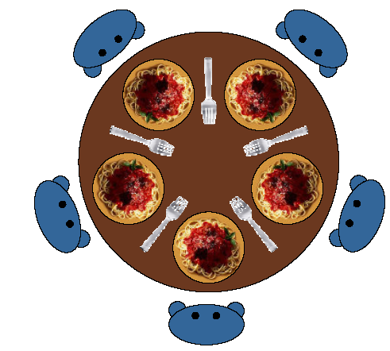
Example of deadlock
Dining Philosophers Problem

Slide 81
Example of deadlock
Boss said to secretary: For a week we will go abroad, so make arrangement. Secretary make call to Husband: For a week my boss and I will be going abroad, you look after yourself. Husband make call to secret lover: My wife is going abroad for a week, so lets spend the week together. Secret lover make call to small boy whom she is giving private tution: I have work for a week, so you need not come for class. Small boy make call to his grandfather: Grandpa, for a week I don't have class 'coz my teacher is busy. Lets spend the week together. Grandpa make call to his secretary: This week I am spending my time with my grandson. We cannot attend that meeting. Secretary make call to her husband: This week my boss has some work, we cancelled our trip. Husband make call to secret lover: We cannot spend this week together, my wife has cancelled her trip. Secret lover make call to small boy whom she is giving private tution: This week we will have class as usual. Small boy make call to his grandfather: Grandpa, my teacher said this week I have to attend class.
Sorry I can't give you company. Grandpa make call to his secretary: Don't worry this week we will attend that meeting, so make arrangement .

Slide 82
DEADLOCKS
Permanent blocking of a single or set of processes, competing for system resources or may want to cooperate for communication.
Formal definition : A set of processes is deadlocked if each process in the set is waiting for an event that only another process in the set can cause.
Usually the event is release of a currently held resource.
Generally it is because of the conflicting needs of different processes.
There is no general solution to solve it completely.

Slide 83
Resource Categories
Reusable resources vs. Consumable resources
Physical vs. logical resources
Preemptable resources vs. Non preemptable resources

Slide 84
Reusable Resources
Can be safely used by only one process at a time and is not depleted by that use
Processors, I/O channels, memory, devices and data structure such as database, files,semaphores etc.
Examples of deadlock with reusable resources
If each process holds on resource and requests for the other
Dining Philosophers
General access pattern:
Request
Lock
Use
Release

Slide 85
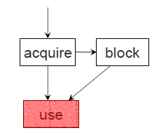
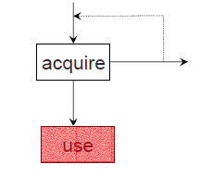
Resources
Process must wait if request is denied
Requesting process may be blocked
May fail with error code
Deadlocks
Occur only when processes are granted
exclusive access to resources

Slide 86
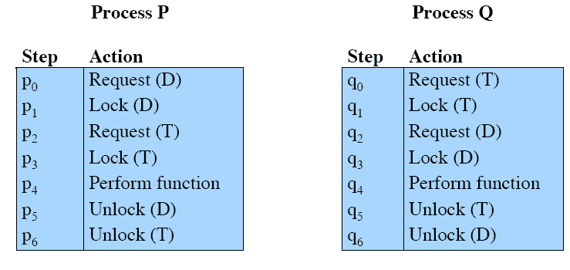
Example of accessing Disk file and Tape drive
Consider sequence p0 p1 q0 q1 p2 q2

Slide 87
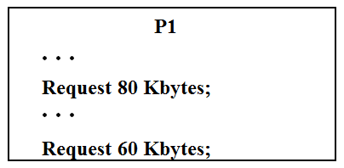
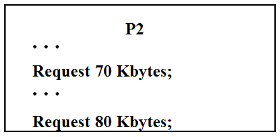
Another Example
Space is available for allocation of 200Kbytes, and the following sequence of events occur
Deadlock occurs if both processes progress to their second request

Slide 88
Consumable Resources
One that can be created/produced and destroyed/consumed
Typically no limit on the number of consumable resources of a particular type
Resource ceases to exist after consumption
Examples
Interrupts, signals, messages, contents of I/O buffers
Can there be deadlock involving consumable resources?

Slide 89
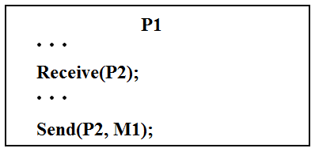
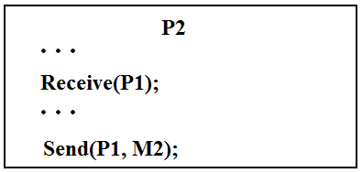
Example
Each process attempts to receive a message from the other and then sends a message to it
Deadlock occurs if the “receive” is blocking
Takes a rare combination of events!
Ever heard that a s/w is never bug free?

Slide 90
Other Kinds
Physical
Printer, tape drive
Logical
File, semaphore, data structure
Preemptable
Can be taken away from process for some time with no ill effects
CPU,memory
Non Preemptable
Will cause process to fail if taken away
Printer
Resource type (e.g. Printer) vs resource instances (e.g. 2)

Slide 91
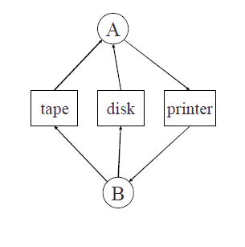
Deadlock Example
utility program
Copies a file from a tape to disk
Prints the file to a printer
Resources
Tape
Disk
Printer
A deadlock

Slide 92
System Model
Resource types R₁, R₂, . . ., R_{m}
CPU cycles, memory space, I/O devices
Each resource type R_{i} has W_{i} instances.
Each process utilizes a resource as follows:
request
use
release
Notes:
92

Slide 93
Deadlock Characterization
Deadlock can arise if four conditions hold simultaneously.
Mutual exclusion :Only single process is allowed to use the resource.
Hold and wait :Process holding at least one resource and waiting to acquire additional resources currently held by other processes.
No preemption :No resource can be removed forcibly from a process.
4. Circular wait: A closed chain of processes exists, such that each process holds at least one resource needed by the next process in the chain
First three are necessary but not sufficient conditions for a deadlock to exist
Notes:
93

Slide 94
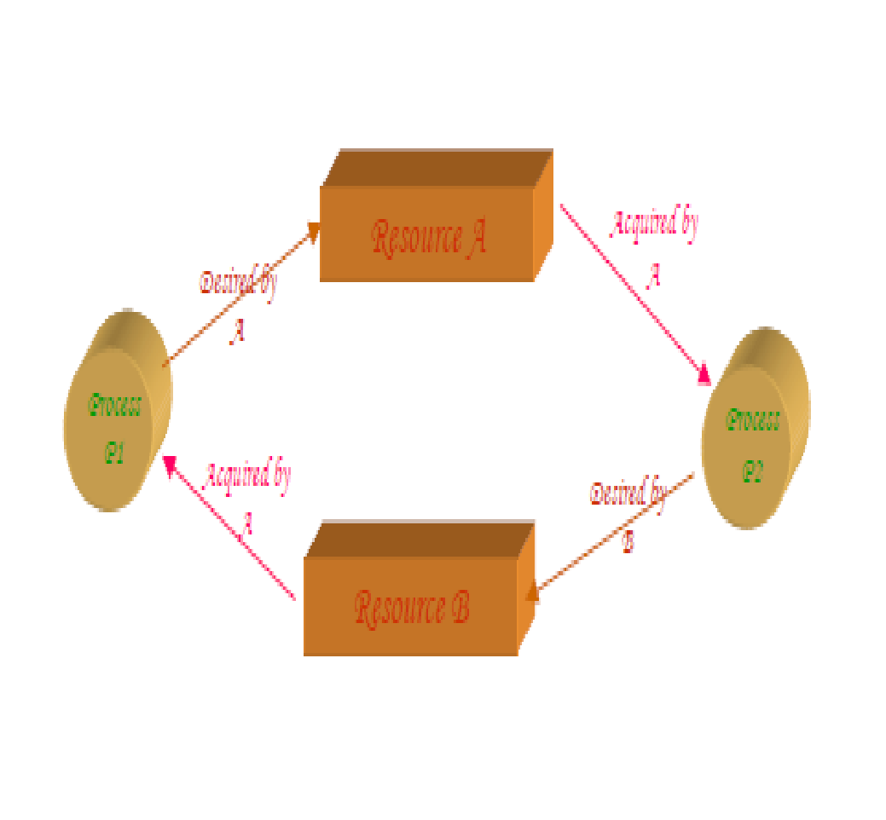
Resource-Allocation Graph

Slide 95
Resource-Allocation Graph
Characterizes allocation of resources to processes.
Directed graph to describe deadlocks
A set of vertices V and a set of edges E.
V is partitioned into two types:
P = {P₁, P₂, …, P_{n}}, the set consisting of all the processes in the system.
R = {R₁, R₂, …, R_{m}}, the set consisting of all resource types in the system.
request edge – directed edge P_{i --🡪} R_{j}
assignment edge – directed edge R_{j} ---🡪 P_{i}
Notes:
95

Slide 96
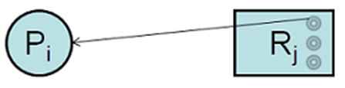
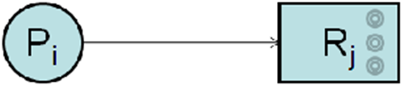
Resource-Allocation Graph (Symbols)
Process node
Resource node
Assignment edge
Request edge
P_{i}
R_{j}

Slide 97
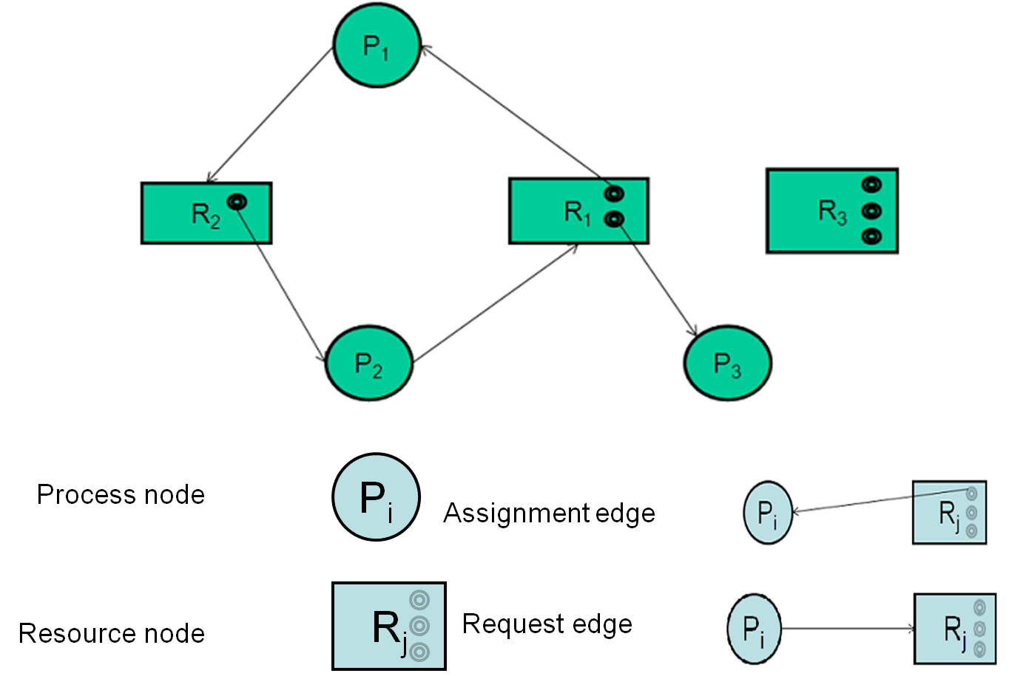
Example of a Resource allocation graph

Slide 98
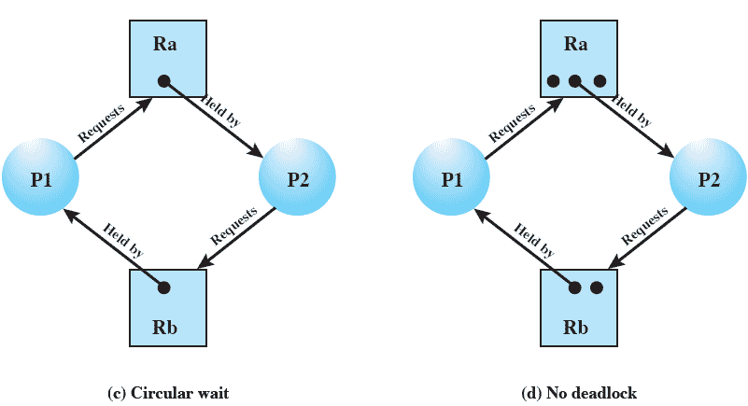
Case Study
Is there a deadlock here?
yes

Slide 99
Case Study
What about this?
no
Notes:
Cycle, but no deadlock
99

Slide 100
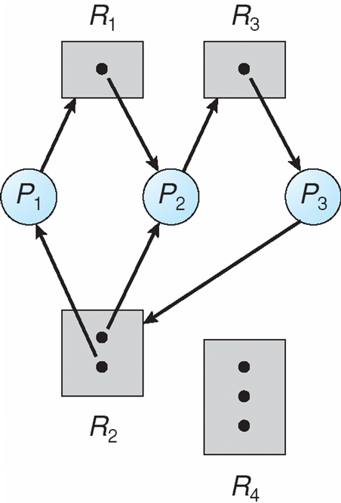
And this?
Yes deadlock
Notes:
Deadlock
100

Slide 101
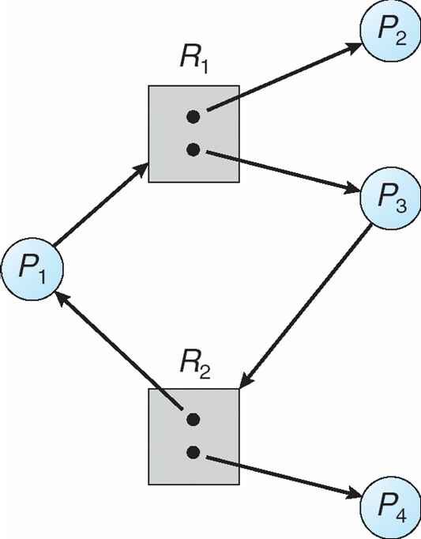
… and this?
Cycle but no deadlock
Notes:
Cycle but no deadlock
101

Slide 102
Basic Facts
Deadlock 🡺 cycle
No cycle 🡺 no deadlock
Cycle 🡺 deadlock
if only one instance per resource type
if several instances per resource type then there is a possibility of a deadlock
If there is single instance of each resource type then cycle in the RAG is necessary and sufficient condition for the existence of a deadlock
If each resource type has multiple instances ,then a cycle is a necessary but not sufficient condition for the existence of a deadlock
Notes:
102

Slide 103
Contents
Uniprocessor Scheduling: Types of Scheduling: Preemptive, Non-preemptive, Long-term, Medium-term,
Short-term scheduling
Scheduling Algorithms: FCFS, SJF, RR, Priority
Multiprocessor Scheduling: Granularity
Design Issues, Process Scheduling
Deadlock: Principles of deadlock,
Deadlock Prevention
Deadlock Avoidance, Deadlock Detection,
Deadlock Recovery
103

Slide 104
Dealing with deadlocks
Four general approaches
Deadlock prevention – by adopting a policy that eliminates one of the four conditions
Deadlock avoidance – by making the appropriate dynamic choices based on the current state of resource allocation
Deadlock detection and recovery – attempt to detect presence of deadlock and take actions to recover
Ignore the problem and pretend that deadlocks never occur in the system
Used by most operating systems, including UNIX & windows
Remains a programmer’s responsibility to write deadlock free code

Slide 105
Deadlock prevention
Design a system in such a way that the possibility of deadlock is excluded by ensuring that at least one of the necessary conditions cannot hold
Two main methods
1. Indirect – prevent all three of the necessary conditions occurring at once (Mutual exclusion, Hold-wait,No-preemption)
2. Direct – prevent Circular wait

Slide 106
Deadlock Prevention: Deny Mutual Exclusion
Mutual Exclusion – not required for sharable resources;
must hold for non-sharable resources.
A process never needs to wait for a sharable resource
But in reality, some resources are intrinsically non-sharable and hence we cannot prevent deadlock by denying mutual exclusion
If access to a resource requires mutual exclusion, then mutual exclusion must be supported by the OS.
Some resources, such as files, may allow multiple accesses for reads but only exclusive access for writes.
Even in this case, deadlock can occur if more than one process requires write permission.
Notes:
106
Example of copying file from tape drive to disk & then printing it.

Slide 107
Deadlock Prevention:Disable hold & wait
Must guarantee that whenever a process requests a resource, it does not hold any other resources
Requires each process to request and be allocated all its resources before it begins execution
Allow process to request resources only when the process has none
Disadvantages:
Low resource utilization
Starvation is possible
Process may not know in advance all of the resources that it will require.

Slide 108
Example
Process that copies data from DVD drive to a file on disk, sorts the file and prints the results to a printer
First protocol
First request DVD drive, disk file and printer
Do the job
Obvious demerit?
Second protocol
Request DVD drive and disk file
Copy, release
Request disk file and printer
Print, release
Problem: data may have changed by now
Starvation common to both
A process that needs several popular resources may have to wait indefinitely because at least one of the resources it needs is always allocated to some other process
Notes:
Low resource utilization
Process may not know what all resources it may need right upfront
108

Slide 109
Deadlock Prevention: Enable Pre-emption
If a process that is holding some resources and requests another resource that cannot be immediately allocated to it, then all resources currently being held are released.
Preempted resources are added to the list of resources for which the process is waiting.
Process will be restarted only when it can regain its old resources, as well as the new ones that it is requesting
Notes:
109

Slide 110
Enable preemption
Alternatively, if a process request some resources
Check if they are available.
If yes, grant
If not, check if they are allocated to some other process that is waiting for additional resources
If yes, preempt desired resources from waiting process and allocate to the requesting process
If no, requesting process must wait
Some of its resources may be preempted, but only if another process requests them
Process resumes only when it is allocated the new resources it is requesting and recovers any resources that were preempted while it was waiting
Often applied to resources whose state can be easily saved and restored – CPU registers, memory space

Slide 111
Deadlock Prevention: Disable Circular Wait
Impose a total ordering of all resource types,.
Each process requests resources in an increasing order of enumeration.
Lets say tape drive is 1, disk drive is 5 and printer is 12
A process can initially request any number of instances of a resource type Ri
After that process can request instances of resource type Rj only if f(j)>f (i)
Alternatively, before requesting Rj, release all Ri such that f(i) >= f(j)
When several instances of same type are needed, a single request for all of them must be issued
Re-ordering of resources requires re-programming
Ordering should be as per usage pattern of resources.

Slide 112
Deadlock Avoidance
Deadlock prevention leads to inefficient use of resources & execution of processes.
Requires that OS be given in advance additional information concerning which resources a process will request and use during its lifetime
Based on this info, OS decides whether to grant the request or delay it
System must consider resources currently available, resources currently allocated, future requests and releases
Notes:
112

Slide 113
Deadlock Avoidance
With this knowledge of complete sequence of requests and releases for each process, system can decide for each request whether or not the process should wait in order to avoid a future deadlock
Variations in algorithms differ in amount and type of information required
Simplest: each process declares the max number of resources of each type that it may need
Dynamically examines the resource allocation state to ensure that a circular wait condition can never exist
State: number of available and allocated resources, maximum demands of processes

Slide 114
Safe State
When a process requests an available resource, system must decide if immediate allocation leaves the system in a safe state.
System is in safe state if there exists a safe sequence of all processes.
Sequence <P₁, P₂, …, P_{n}> is safe if for each P_{i}, the resources that P_{i} can still request can be satisfied by currently available resources + resources held by all the P_{j}, with j<i.
If P_{i} resource needs are not immediately available, then P_{i} can wait until all P_{j} have finished.
When P_{j} is finished, P_{i} can obtain needed resources, execute, return allocated resources, and terminate.
When P_{i} terminates, P_{i+1} can obtain its needed resources, and so on.

Slide 115
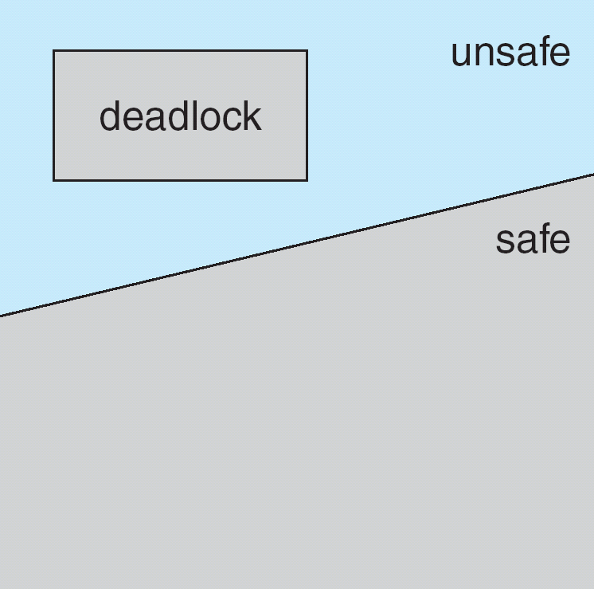
Safe, Unsafe , Deadlock State
Safe state is not a deadlocked state
Deadlocked state is an unsafe state
Not all unsafe states are deadlocks
Unsafe state may lead to a deadlock
Better to always be in safe state
Notes:
115

Slide 116
Example
12 magnetic tape drives, 3 processes
Snapshot at t0
3 more tape drives available
System is in safe state with sequence P1, P0, P2
Process | Maximum needs | Currently holding
P0 | 10 | 5
P1 | 4 | 2
P2 | 9 | 2

Slide 117
From safe to unsafe state
Suppose at t1, P2 requests and is allocated 1 more tape drive
System is no longer in safe state
Only P1 can be allocated now. When done, both P0 and P2 will have to wait forever!
If only we had made P2 wait until either of the other processes had finished, we could have avoided the deadlock
Process | Maximum needs | Currently holding
P0 | 10 | 5
P1 | 4 | 2
P2 | 9 | 3

Slide 118
bottom line of avoidance algorithms
Grant request only if the system remains in the safe state
Even if the resources it is asking for is currently available

Slide 119
Avoidance algorithms
When single instance of all resource types use RAG algorithm
Uses a variant of the RAG we saw earlier
When multiple instances of resource types,
- Use Banker’s algorithm
Notes:
119

Slide 120
Resource-Allocation Graph Scheme
Claim edge P_{i} → R_{j} indicated that process P_{i} may request resource R_{j} at some time in future
Similar to request edge in direction but is represented by a dashed line
when a process requests a resource, Claim edge converts to request edge
Request edge converted to an assignment edge when the resource is allocated to the process.
When a resource is released by a process, assignment edge reconverted to a claim edge
Resources must be claimed a prior in the system
Notes:
120

Slide 121
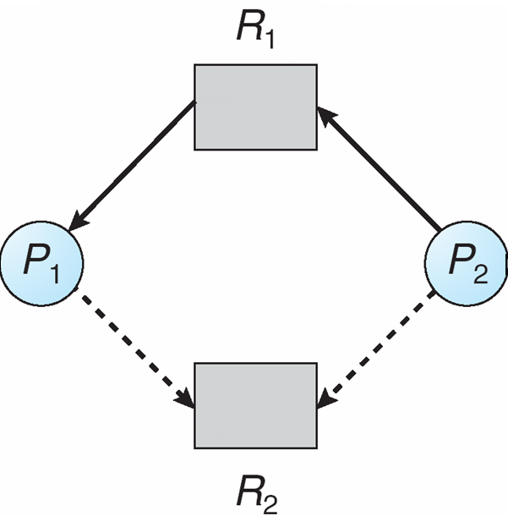
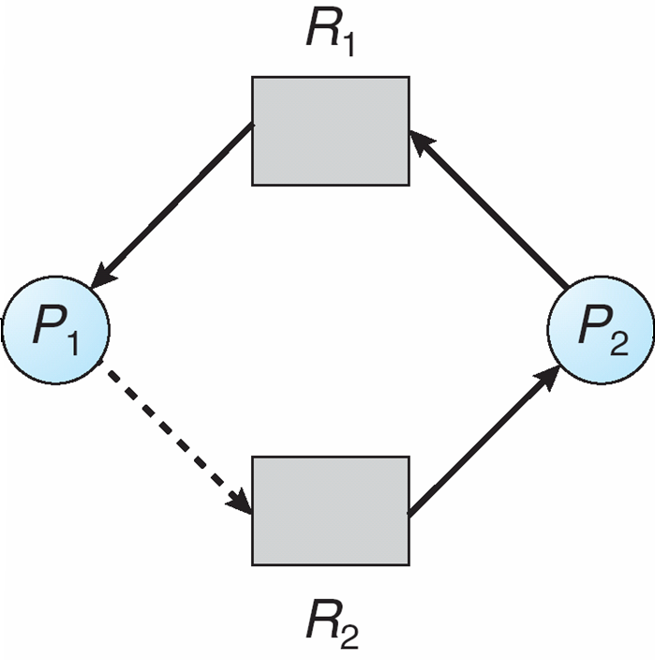
Resource-Allocation Graph
Snapshot at time t
Suppose P2 requests R2
Although R2 is currently free it cannot be allocated to P2
Cycle!
Notes:
121

Slide 122
Resource-Allocation Graph Algorithm
Suppose that process P_{i} requests a resource R_{j}
The request can be granted only if converting the request edge to an assignment edge does not result in the formation of a cycle in the resource allocation graph.
Time complexity: For detecting a cycle in a graph it requires an order of n² operations, Where n in number of processes in the system.
Notes:
122

Slide 123
Banker’s Algorithm
Multiple instances of each resource type.
Each process must a prior claim maximum use.
Every process declares it maximum need/requirement.
Maximum requirement should not exceed the total number of resources in the system.
When a process requests a resource, system determines whether allocation will keep the system in safe state or not.
If it is, resources get allocated. Otherwise need to wait until resources get available.
When a process gets all its resources it must return them in a finite amount of time.
Notes:
123

Slide 124
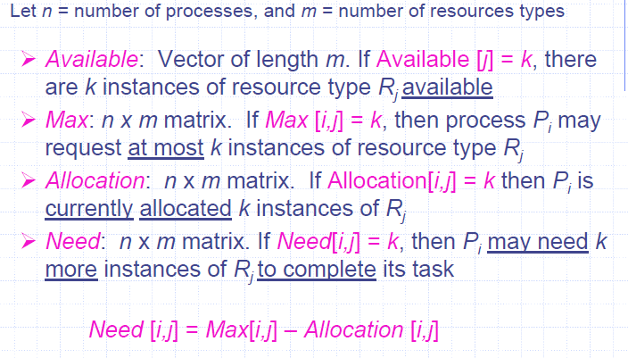
Data Structures for the Banker’s Algorithm
Notes:
124

Slide 125
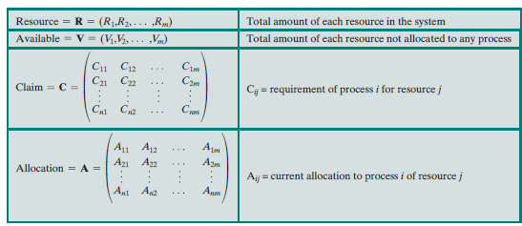

Slide 126

Following relationship holds

Slide 127

Safety Algorithm
Requires m * n² operation to decide whether a state is safe.
Notes:
127

Slide 128
Example
5 processes P0 through P4
3 resource types: A (10 instances), B (5 instances), and C (7 instances)
Snapshot of system at t₀
Process | Allocation |  |  | Max |  |  | Need
 | A | B | C | A | B | C | A | B | C
P₀ | 0 | 1 | 0 | 7 | 5 | 3
P₁ | 2 | 0 | 0 | 3 | 2 | 2
P₂ | 3 | 0 | 2 | 9 | 0 | 2
P₃ | 2 | 1 | 1 | 2 | 2 | 2
P₄ | 0 | 0 | 2 | 4 | 3 | 3

Slide 129
Example
5 processes P0 through P4
3 resource types: A (10 instances), B (5 instances), and C (7 instances)
Snapshot of system at t₀ : is it safe?
Process | Allocation |  |  | Max |  |  | Need
 | A | B | C | A | B | C | A | B | C
P₀ | 0 | 1 | 0 | 7 | 5 | 3 | 7 | 4 | 3
P₁ | 2 | 0 | 0 | 3 | 2 | 2 | 1 | 2 | 2
P₂ | 3 | 0 | 2 | 9 | 0 | 2 | 6 | 0 | 0
P₃ | 2 | 1 | 1 | 2 | 2 | 2 | 0 | 1 | 1
P₄ | 0 | 0 | 2 | 4 | 3 | 3 | 4 | 3 | 1

Slide 130
Safe State?
Process | Allocation |  |  | Need |  |  | Finish | Finish | Finish | Finish | Finish
 | A | B | C | A | B | C
P₀ | 0 | 1 | 0 | 7 | 4 | 3 | F
P₁ | 2 | 0 | 0 | 1 | 2 | 2 | F
P₂ | 3 | 0 | 2 | 6 | 0 | 0 | F
P₃ | 2 | 1 | 1 | 0 | 1 | 1 | F
P₄ | 0 | 0 | 2 | 4 | 3 | 1 | F
Work
3 | 3 | 2

Slide 131
Safe State?
Process | Allocation |  |  | Need |  |  | Finish | Finish | Finish | Finish | Finish
 | A | B | C | A | B | C
P₀ | 0 | 1 | 0 | 7 | 4 | 3 | F | F
P₁ | 2 | 0 | 0 | 1 | 2 | 2 | F | T
P₂ | 3 | 0 | 2 | 6 | 0 | 0 | F | F
P₃ | 2 | 1 | 1 | 0 | 1 | 1 | F | F
P₄ | 0 | 0 | 2 | 4 | 3 | 1 | F | F
Work
3 | 3 | 2
5 | 3 | 2

Slide 132
Safe State?
Process | Allocation |  |  | Need |  |  | Finish | Finish | Finish | Finish | Finish
 | A | B | C | A | B | C
P₀ | 0 | 1 | 0 | 7 | 4 | 3 | F | F | F
P₁ | 2 | 0 | 0 | 1 | 2 | 2 | F | T | T
P₂ | 3 | 0 | 2 | 6 | 0 | 0 | F | F | F
P₃ | 2 | 1 | 1 | 0 | 1 | 1 | F | F | T
P₄ | 0 | 0 | 2 | 4 | 3 | 1 | F | F | F
Work
3 | 3 | 2
5 | 3 | 2
7 | 4 | 3

Slide 133
Safe State?
Process | Allocation |  |  | Need |  |  | Finish | Finish | Finish | Finish | Finish
 | A | B | C | A | B | C
P₀ | 0 | 1 | 0 | 7 | 4 | 3 | F | F | F | T
P₁ | 2 | 0 | 0 | 1 | 2 | 2 | F | T | T | T
P₂ | 3 | 0 | 2 | 6 | 0 | 0 | F | F | F | F
P₃ | 2 | 1 | 1 | 0 | 1 | 1 | F | F | T | T
P₄ | 0 | 0 | 2 | 4 | 3 | 1 | F | F | F | F
Work
3 | 3 | 2
5 | 3 | 2
7 | 4 | 3
7 | 5 | 3

Slide 134
Safe State?
Process | Allocation |  |  | Need |  |  | Finish | Finish | Finish | Finish | Finish
 | A | B | C | A | B | C
P₀ | 0 | 1 | 0 | 7 | 4 | 3 | F | F | F | T | T
P₁ | 2 | 0 | 0 | 1 | 2 | 2 | F | T | T | T | T
P₂ | 3 | 0 | 2 | 6 | 0 | 0 | F | F | F | F | T
P₃ | 2 | 1 | 1 | 0 | 1 | 1 | F | F | T | T | T
P₄ | 0 | 0 | 2 | 4 | 3 | 1 | F | F | F | F | F
Work
3 | 3 | 2
5 | 3 | 2
7 | 4 | 3
7 | 5 | 3
10 | 5 | 5

Slide 135
Safe State?
Process | Allocation |  |  | Need |  |  | Finish | Finish | Finish | Finish | Finish | Finish
 | A | B | C | A | B | C
P₀ | 0 | 1 | 0 | 7 | 4 | 3 | F | F | F | T | T | T
P₁ | 2 | 0 | 0 | 1 | 2 | 2 | F | T | T | T | T | T
P₂ | 3 | 0 | 2 | 6 | 0 | 0 | F | F | F | F | T | T
P₃ | 2 | 1 | 1 | 0 | 1 | 1 | F | F | T | T | T | T
P₄ | 0 | 0 | 2 | 4 | 3 | 1 | F | F | F | F | F | T
Work
3 | 3 | 2
5 | 3 | 2
7 | 4 | 3
7 | 5 | 3
10 | 5 | 5
10 | 5 | 7
Safe Sequence: <P1, P3, P0, P2, P4>

Slide 136

Resource-Request Algorithm
Notes:
136

Slide 137
Example: P₁ Request (1,0,2)
Check that Request ≤ need that is, (1,0,2) ≤ (1,2,2) ⇒ true
Check that Request ≤ Available that is, (1,0,2) ≤ (3,3,2) ⇒ true
Allocation Need Available
A B C A B C A B C
P₀ 0 1 0 7 4 3 2 3 0
P₁ 3 0 2 0 2 0
P₂ 3 0 2 6 0 0
P₃ 2 1 1 0 1 1
P₄ 0 0 2 4 3 1
Can request for (3,3,0) by P₄ be granted?
Can request for (0,2,0) by P₀ be granted?
Notes:
137

Slide 138
Request₁ = (1, 0, 2)
Request <need that is, (1,0,2) < (1,2,2) ->true
Request₁ <= Available
(1, 0, 2) <= (3, 3, 2)
Pretend to grant
Allocation₁ , Need₁ , Available will change (2, 3, 0)
Process | Allocation |  |  | Max |  |  | Need
 | A | B | C | A | B | C | A | B | C
P₀ | 0 | 1 | 0 | 7 | 5 | 3 | 7 | 4 | 3
P₁ | 3 | 0 | 2 | 3 | 2 | 2 | 0 | 2 | 0
P₂ | 3 | 0 | 2 | 9 | 0 | 2 | 6 | 0 | 0
P₃ | 2 | 1 | 1 | 2 | 2 | 2 | 0 | 1 | 1
P₄ | 0 | 0 | 2 | 4 | 3 | 3 | 4 | 3 | 1

Slide 139
Is the state safe?
Process | Allocation |  |  | Need |  |  | Finish | Finish | Finish | Finish | Finish
 | A | B | C | A | B | C
P₀ | 0 | 1 | 0 | 7 | 4 | 3 | F
P₁ | 3 | 0 | 2 | 0 | 2 | 0 | F
P₂ | 3 | 0 | 2 | 6 | 0 | 0 | F
P₃ | 2 | 1 | 1 | 0 | 1 | 1 | F
P₄ | 0 | 0 | 2 | 4 | 3 | 1 | F
Work
2 | 3 | 0

Slide 140
Is the state safe?
Process | Allocation |  |  | Need |  |  | Finish | Finish | Finish | Finish | Finish
 | A | B | C | A | B | C
P₀ | 0 | 1 | 0 | 7 | 4 | 3 | F | F
P₁ | 3 | 0 | 2 | 0 | 2 | 0 | F | T
P₂ | 3 | 0 | 2 | 6 | 0 | 0 | F | F
P₃ | 2 | 1 | 1 | 0 | 1 | 1 | F | F
P₄ | 0 | 0 | 2 | 4 | 3 | 1 | F | F
Work
2 | 3 | 0
5 | 3 | 2

Slide 141
Is the state safe?
Process | Allocation |  |  | Need |  |  | Finish | Finish | Finish | Finish | Finish
 | A | B | C | A | B | C
P₀ | 0 | 1 | 0 | 7 | 4 | 3 | F | F | F
P₁ | 3 | 0 | 2 | 0 | 2 | 0 | F | T | T
P₂ | 3 | 0 | 2 | 6 | 0 | 0 | F | F | F
P₃ | 2 | 1 | 1 | 0 | 1 | 1 | F | F | T
P₄ | 0 | 0 | 2 | 4 | 3 | 1 | F | F | F
Work
2 | 3 | 0
5 | 3 | 2
7 | 4 | 3

Slide 142
Is the state safe?
Process | Allocation |  |  | Need |  |  | Finish | Finish | Finish | Finish | Finish
 | A | B | C | A | B | C
P₀ | 0 | 1 | 0 | 7 | 4 | 3 | F | F | F | T
P₁ | 3 | 0 | 2 | 0 | 2 | 0 | F | T | T | T
P₂ | 3 | 0 | 2 | 6 | 0 | 0 | F | F | F | F
P₃ | 2 | 1 | 1 | 0 | 1 | 1 | F | F | T | T
P₄ | 0 | 0 | 2 | 4 | 3 | 1 | F | F | F | F
Work
2 | 3 | 0
5 | 3 | 2
7 | 4 | 3
7 | 5 | 3

Slide 143
Is the state safe?
Process | Allocation |  |  | Need |  |  | Finish | Finish | Finish | Finish | Finish
 | A | B | C | A | B | C
P₀ | 0 | 1 | 0 | 7 | 4 | 3 | F | F | F | T | T
P₁ | 3 | 0 | 2 | 0 | 2 | 0 | F | T | T | T | T
P₂ | 3 | 0 | 2 | 6 | 0 | 0 | F | F | F | F | T
P₃ | 2 | 1 | 1 | 0 | 1 | 1 | F | F | T | T | T
P₄ | 0 | 0 | 2 | 4 | 3 | 1 | F | F | F | F | F
Work
2 | 3 | 0
5 | 3 | 2
7 | 4 | 3
7 | 5 | 3
10 | 5 | 5

Slide 144
Is the state safe?
Process | Allocation |  |  | Need |  |  | Finish | Finish | Finish | Finish | Finish | Finish
 | A | B | C | A | B | C
P₀ | 0 | 1 | 0 | 7 | 4 | 3 | F | F | F | T | T | T
P₁ | 3 | 0 | 2 | 0 | 2 | 0 | F | T | T | T | T | T
P₂ | 3 | 0 | 2 | 6 | 0 | 0 | F | F | F | F | T | T
P₃ | 2 | 1 | 1 | 0 | 1 | 1 | F | F | T | T | T | T
P₄ | 0 | 0 | 2 | 4 | 3 | 1 | F | F | F | F | F | T
Work
2 | 3 | 0
5 | 3 | 2
7 | 4 | 3
7 | 5 | 3
10 | 5 | 5
10 | 5 | 7
Safe Sequence: <P1, P3, P0, P2, P4>

Slide 145
Request₄ = (3, 3, 0)
Request₄ <= Available?
(3, 3, 0) <= (2, 3, 0)?
No. Thus request from P4 cannot be granted

Slide 146
Request₀ = (0, 2, 0)
Request₀ <= Available
(0, 2, 0) <= (2, 3, 0)
Pretend to grant
Allocation₀ , Need₀ , Available will change (2, 1, 0)
Process | Allocation |  |  | Max |  |  | Need
 | A | B | C | A | B | C | A | B | C
P₀ | 0 | 3 | 0 | 7 | 5 | 3 | 7 | 2 | 3
P₁ | 3 | 0 | 2 | 3 | 2 | 2 | 0 | 2 | 0
P₂ | 3 | 0 | 2 | 9 | 0 | 2 | 6 | 0 | 0
P₃ | 2 | 1 | 1 | 2 | 2 | 2 | 0 | 1 | 1
P₄ | 0 | 0 | 2 | 4 | 3 | 3 | 4 | 3 | 1

Slide 147
Is the state safe?
Process | Allocation |  |  | Need |  |  | Finish | Finish | Finish | Finish | Finish
 | A | B | C | A | B | C
P₀ | 0 | 3 | 0 | 7 | 2 | 3 | F
P₁ | 3 | 0 | 2 | 0 | 2 | 0 | F
P₂ | 3 | 0 | 2 | 6 | 0 | 0 | F
P₃ | 2 | 1 | 1 | 0 | 1 | 1 | F
P₄ | 0 | 0 | 2 | 4 | 3 | 1 | F
Work
2 | 1 | 0

Slide 148
Is the state safe?
Process | Allocation |  |  | Need |  |  | Finish | Finish | Finish | Finish | Finish
 | A | B | C | A | B | C
P₀ | 0 | 3 | 0 | 7 | 2 | 3 | F
P₁ | 3 | 0 | 2 | 0 | 2 | 0 | F
P₂ | 3 | 0 | 2 | 6 | 0 | 0 | F
P₃ | 2 | 1 | 1 | 0 | 1 | 1 | F
P₄ | 0 | 0 | 2 | 4 | 3 | 1 | F
Work
2 | 1 | 0

Slide 149
Example : Is the below system in safe state?
Process | Allocation |  |  |  | Max
 | A | B | C | D | A | B | C | D
P₀ | 0 | 0 | 1 | 2 | 0 | 0 | 1 | 2
P₁ | 1 | 0 | 0 | 0 | 1 | 7 | 5 | 0
P₂ | 1 | 3 | 5 | 4 | 2 | 3 | 5 | 6
P₃ | 0 | 6 | 3 | 2 | 0 | 6 | 5 | 2
P₄ | 0 | 0 | 1 | 4 | 0 | 6 | 5 | 6
Available
1 | 5 | 2 | 0

Slide 150
Deadlock Detection
When neither prevention nor avoidance is employed, a deadlock situation may arise
System can provide an algorithm to detect an algorithm and an algorithm to recover from it if it has occurred
Requires overhead that includes not only the run-time costs of maintaining the necessary information and executing the detection algorithm but also the potential losses inherent in recovering from a deadlock

Slide 151
Case 1: Single instance of each resource type
Use a variant of RAG called WFG
by removing the resource nodes and collapsing the appropriate edges
An edge from P_{i} to P_{j} in a wait-for graph implies that
process P_{i} is waiting for process P_{j} to release a resource that P_{i} needs
if the corresponding RAG contains two edges
P_{i} 🡪 R_{q} and R_{q} 🡪 P_{j} for some R_{q}
Periodically invoke an algorithm that searches for a cycle in the WFG
If there is a cycle, there exists a deadlock.
O(n^2) operations

Slide 152


Resource-Allocation Graph and Wait-for Graph

Slide 153


Resource-Allocation Graph and Wait-for Graph
Resource-Allocation Graph
Corresponding wait-for graph
Notes:
153

Slide 154
Case 2: Several instances of each resource type
WFG is no longer applicable for this case
Why?
Detection algorithm
Uses several time varying data structures similar to those of Banker’s
Available (m), Allocation (nXm), Request(nXm)
Same definition of <= notation
Same definition of Allocation_{i} and Request_{i}
Crux of the algorithm
Simply investigates every possible allocation sequence for the processes that remain to be completed

Slide 155

Case 2: Several instances of each resource type

Slide 156

Deadlock Detection Algorithm
Requires m * n² operation to detect a deadlock

Slide 157

Contrast with Banker’s Algorithm

Slide 158
Example
5 processes P0 through P4
3 resource types: A (7 instances), B (2 instances), and C (6 instances)
Snapshot of system at t₀ : is there a deadlock?
Process | Allocation |  |  | Request
 | A | B | C | A | B | C
P₀ | 0 | 1 | 0 | 0 | 0 | 0
P₁ | 2 | 0 | 0 | 2 | 0 | 2
P₂ | 3 | 0 | 3 | 0 | 0 | 0
P₃ | 2 | 1 | 1 | 1 | 0 | 0
P₄ | 0 | 0 | 2 | 0 | 0 | 2
Available
0 | 0 | 0

Slide 159
Is there a deadlock?
Process | Allocation |  |  | Request |  |  | Finish | Finish | Finish | Finish | Finish
 | A | B | C | A | B | C
P₀ | 0 | 1 | 0 | 0 | 0 | 0 | F
P₁ | 2 | 0 | 0 | 2 | 0 | 2 | F
P₂ | 3 | 0 | 3 | 0 | 0 | 0 | F
P₃ | 2 | 1 | 1 | 1 | 0 | 0 | F
P₄ | 0 | 0 | 2 | 0 | 0 | 2 | F
Work
0 | 0 | 0
Please note that all are initially ‘F’ here by coincidence

Slide 160
Is there a deadlock?
Process | Allocation |  |  | Request |  |  | Finish | Finish | Finish | Finish | Finish
 | A | B | C | A | B | C
P₀ | 0 | 1 | 0 | 0 | 0 | 0 | F | T
P₁ | 2 | 0 | 0 | 2 | 0 | 2 | F | F
P₂ | 3 | 0 | 3 | 0 | 0 | 0 | F | F
P₃ | 2 | 1 | 1 | 1 | 0 | 0 | F | F
P₄ | 0 | 0 | 2 | 0 | 0 | 2 | F | F
Work
0 | 0 | 0
0 | 1 | 0

Slide 161
Is there a deadlock?
Process | Allocation |  |  | Request |  |  | Finish | Finish | Finish | Finish | Finish
 | A | B | C | A | B | C
P₀ | 0 | 1 | 0 | 0 | 0 | 0 | F | T | T
P₁ | 2 | 0 | 0 | 2 | 0 | 2 | F | F | F
P₂ | 3 | 0 | 3 | 0 | 0 | 0 | F | F | T
P₃ | 2 | 1 | 1 | 1 | 0 | 0 | F | F | F
P₄ | 0 | 0 | 2 | 0 | 0 | 2 | F | F | F
Work
0 | 0 | 0
0 | 1 | 0
3 | 1 | 3

Slide 162
Is there a deadlock?
Process | Allocation |  |  | Request |  |  | Finish | Finish | Finish | Finish | Finish
 | A | B | C | A | B | C
P₀ | 0 | 1 | 0 | 0 | 0 | 0 | F | T | T | T
P₁ | 2 | 0 | 0 | 2 | 0 | 2 | F | F | F | T
P₂ | 3 | 0 | 3 | 0 | 0 | 0 | F | F | T | T
P₃ | 2 | 1 | 1 | 1 | 0 | 0 | F | F | F | F
P₄ | 0 | 0 | 2 | 0 | 0 | 2 | F | F | F | F
Work
0 | 0 | 0
0 | 1 | 0
3 | 1 | 3
5 | 1 | 3

Slide 163
Is there a deadlock?
Process | Allocation |  |  | Request |  |  | Finish | Finish | Finish | Finish | Finish
 | A | B | C | A | B | C
P₀ | 0 | 1 | 0 | 0 | 0 | 0 | F | T | T | T | T
P₁ | 2 | 0 | 0 | 2 | 0 | 2 | F | F | F | T | T
P₂ | 3 | 0 | 3 | 0 | 0 | 0 | F | F | T | T | T
P₃ | 2 | 1 | 1 | 1 | 0 | 0 | F | F | F | F | T
P₄ | 0 | 0 | 2 | 0 | 0 | 2 | F | F | F | F | F
Work
0 | 0 | 0
0 | 1 | 0
3 | 1 | 3
5 | 1 | 3
7 | 2 | 4

Slide 164
Is there a deadlock?
Process | Allocation |  |  | Request |  |  | Finish | Finish | Finish | Finish | Finish
 | A | B | C | A | B | C
P₀ | 0 | 1 | 0 | 0 | 0 | 0 | F | T | T | T | T | T
P₁ | 2 | 0 | 0 | 2 | 0 | 2 | F | F | F | T | T | T
P₂ | 3 | 0 | 3 | 0 | 0 | 0 | F | F | T | T | T | T
P₃ | 2 | 1 | 1 | 1 | 0 | 0 | F | F | F | F | T | T
P₄ | 0 | 0 | 2 | 0 | 0 | 2 | F | F | F | F | F | T
Work
0 | 0 | 0
0 | 1 | 0
3 | 1 | 3
5 | 1 | 3
7 | 2 | 4
7 | 2 | 6
Thus, no deadlock: Sequence <P₀, P₂, P₃, P₁, P₄>

Slide 165
P2 now makes an additional request for 1 C
Request matrix is modified. Is there deadlock now?
Process | Allocation |  |  | Request |  |  | Finish | Finish | Finish | Finish | Finish
 | A | B | C | A | B | C
P₀ | 0 | 1 | 0 | 0 | 0 | 0 | F
P₁ | 2 | 0 | 0 | 2 | 0 | 2 | F
P₂ | 3 | 0 | 3 | 0 | 0 | 1 | F
P₃ | 2 | 1 | 1 | 1 | 0 | 0 | F
P₄ | 0 | 0 | 2 | 0 | 0 | 2 | F
Work
0 | 0 | 0

Slide 166
Is there a deadlock?
Process | Allocation |  |  | Request |  |  | Finish | Finish | Finish | Finish | Finish
 | A | B | C | A | B | C
P₀ | 0 | 1 | 0 | 0 | 0 | 0 | F | T
P₁ | 2 | 0 | 0 | 2 | 0 | 2 | F | F
P₂ | 3 | 0 | 3 | 0 | 0 | 1 | F | F
P₃ | 2 | 1 | 1 | 1 | 0 | 0 | F | F
P₄ | 0 | 0 | 2 | 0 | 0 | 2 | F | F
Work
0 | 0 | 0
0 | 1 | 0

Slide 167
Is there a deadlock?
Process | Allocation |  |  | Request |  |  | Finish | Finish | Finish | Finish | Finish
 | A | B | C | A | B | C
P₀ | 0 | 1 | 0 | 0 | 0 | 0 | F | T
P₁ | 2 | 0 | 0 | 2 | 0 | 2 | F | F
P₂ | 3 | 0 | 3 | 0 | 0 | 1 | F | F
P₃ | 2 | 1 | 1 | 1 | 0 | 0 | F | F
P₄ | 0 | 0 | 2 | 0 | 0 | 2 | F | F
Work
0 | 0 | 0
0 | 1 | 0
P1, P2, P3 and P4 are in a deadlock now!

Slide 168

Example: Multiple resources of each type

Slide 169

Example: Multiple resources of each type

Slide 170
Detection-Algorithm Usage
When, and how often, to invoke algorithm depends on:
How often a deadlock is likely to occur?
How many processes will be affected by deadlock when it happens?
If deadlock occurs frequently, then the detection algorithm should be invoked frequently.
We could invoke the deadlock detection algorithm every time a request for allocation cannot be granted immediately.
By this we can identify deadlock causing process & processes involved in deadlock also.
But this incurs overhead in computation time.
So can call algorithms after 1 hour / CPU utilization drops below 40%.
If detection algorithm is invoked arbitrarily, there may be many cycles in the resource graph and so we would not be able to tell which of the many deadlocked processes “caused” the deadlock.
Notes:
170

Slide 171
Contents
Uniprocessor Scheduling: Types of Scheduling: Preemptive, Non-preemptive, Long-term, Medium-term, Short-term scheduling
Scheduling Algorithms: FCFS, SJF, RR, Priority
Multiprocessor Scheduling: Granularity
Design Issues, Process Scheduling
Deadlock: Principles of deadlock, Deadlock Avoidance
Deadlock Detection, Deadlock Prevention
Deadlock Recovery
171

Slide 172
Deadlock Recovery
Once detected, several alternatives are available for recovery inform the operator that a deadlock has occurred and to let the operator deal with the deadlock manually
Abort one or more processes to break the circular wait
Preempt some resources from one or more of the deadlocked processes

Slide 173
Process Termination / Abort
Two alternatives
In both, system reclaims all resources held by the terminated process
Abort all deadlocked processes
Everything the processes had done so far has gone down the drain!
Abort one process at a time until the deadlock cycle is eliminated
Whose turn is next?
Policy decision similar to scheduling decisions
Considerable overhead of detecting deadlock after each termination!
Aborting comes with several issues
What if in the middle of updating a file or printing to a printer

Slide 174
Whom to abort next?
Abort those processes whose termination will incur the minimum cost
Cost depends upon
What is the priority of the process?
How long the process has computed and how much longer the process will compute before completing its designated task?
How many and what type of resources the process has used (e.g., preemptable, non-preemptable)?
How many more resources the process needs in order to complete?
How many processes will need to be terminated?
Whether the process is interactive or batch?

Slide 175
Resource Preemption
We successively preempt some resources from processes and give these resources to other processes until the deadlock cycle is broken
Three issues need to be addressed:
Selecting a victim
Rollback
Starvation

Slide 176
Selecting a victim
Which resources and of which processes next in order to minimize cost

Slide 177
Rollback
What to do with the process from whom resource has been preempted? It cannot continue normal execution
Rollback to some safe state and restart it from that state
What is safe state, also system will require to keep states of all processes
Thus some systems prefer total rollback

Slide 178
Starvation
How can we guarantee that resources will not always be preempted from the same process
If decision to pick is primarily based on cost factors, same unfortunate fellow may get picked up every time!
We thus need an upper bound (small and finite) on how many times you can be chosen as a victim
Include the number of rollbacks in the cost factor

Slide 179

Summary of Deadlock prevention, Avoidance,Detection

Slide 180
Self Study
Thread Scheduling
Real-time scheduling

Slide 181
Thread scheduling
An application can be implemented as a set of threads that cooperate and execute concurrently in the same address space. Criteria: When related threads run in parallel performance improves.
Load sharing: processes are not assigned to a particular processor.
A global queue of ready threads is maintained and idle processor selects thread from the queue.
Gang scheduling: Bunch of related threads scheduled together to run on a set of processors at the same time, on one –to one basis.

Slide 182
Thread scheduling
Dedicated processor assignment: Each program gets as many processors as there are parallel threads.
Dynamic scheduling: Scheduling done at run time.

Slide 183
Load sharing:
Advantages:
The load is distributed evenly across the processors, assuring that no processor is idle.
No centralizer scheduler is required
Three versions of Load sharing:
FCFS
Smallest number of threads first
Pre-emptive smallest number of threads first

Slide 184
Real-time systems
Real-time computing is an important emerging discipline in CS and CE.
Control of lab experiments, robotics, process control, telecommunication etc.
It is a type of computing where correctness of the computation depends not only on the logical results but also on the time at which the results are produced.
Hard real-time systems: Must meet deadline. Ex: Space shuttle rendezvous with other space station.
Soft real-time system: Deadlines are there but not mandatory. Results are discarded if the deadline is not met.

Slide 185
Characteristics of Real-Time (RT) systems
Determinism
Responsiveness
User control
Reliability
Fail-soft operation

Slide 186
Deterministic Response
External event and timings dictate the request of service.
OS’s response depends on the speed at which it can respond to interrupts and on whether the system has sufficient capacity to handle requests.
Determinism is concerned with how long the OS delays before acknowledging an interrupt.
In non-RT this delay may be in the order of 10’s and 100’s of millisecs, whereas in an RT it may have few microsec to 1millisec.

Slide 187
RT .. Responsiveness
Responsiveness is the time for servicing the interrupt once it has been acknowledged.
Comprises:
Time to transfer control, (and context switch) and execute the ISR
Time to handle nested interrupts, the interrupts that should be serviced when executing this ISR. Higher priority Interrupts.
response time = F(responsiveness, determinism)

Slide 188
RT .. User Control
User control : User has a much broader control in RT-OS than in regular OS.
Priority
Hard or soft deadlines
Deadlines

Slide 189
RT .. Reliability
Reliability: A processor failure in a non-RT may result in reduced level of service. But in an RT it may be catastrophic : life and death, financial loss, equipment damage.

Slide 190
Fail-soft operation:
Fail-soft operation: Ability of the system to fail in such a way preserve as much capability and data as possible.
In the event of a failure, immediate detection and correction is important.
Notify user processes to rollback.

Slide 191
Requirements of RT
Fast context switch
Minimal functionality (small size)
Ability to respond to interrupts quickly (Special interrupts handlers)
Multitasking with signals and alarms
Special storage to accumulate data fast
Pre-emptive scheduling

Slide 192
Requirements of RT (contd.)
Priority levels
Minimizing interrupt disables
Short-term scheduler (“omni-potent”)
Time monitor
Goal: Complete all hard real-time tasks by dead-line. Complete as many soft real-time tasks as possible by their deadline.

Slide 193
RT scheduling
Static table-driven approach
Static priority-driven preemptive scheduling
Dynamic planning-based scheduling
Dynamic best-effort scheduling:

Slide 194
RT scheduling
Static table-driven approach
For periodic tasks.
Input for analysis consists of : periodic arrival time, execution time, ending time, priorities.
Inflexible to dynamic changes.
General policy: earliest deadline first.

Slide 195
RT scheduling
Static priority-driven preemptive scheduling
For use with non-RT systems: Priority based preemptive scheduling.
Priority assignment based on real-time constraints.
Example: Rate monotonic algorithm

Slide 196
RT scheduling
Dynamic planning-based scheduling
After the task arrives before execution begins, a schedule is prepared that includes the new as well as the existing tasks.
If the new one can go without affecting the existing schedules than nothing is revised.
Else schedules are revised to accommodate the new task.
Remember that sometimes new tasks may be rejected if deadlines cannot be met.

Slide 197
RT scheduling
Dynamic best-effort scheduling:
used in most commercial RTs of today
tasks are aperiodic, no static scheduling is possible
some short-term scheduling such as shortest deadline first is used.
Until the task completes we do not know whether it has met the deadline.

Slide 198
End of Chapter
Notes:
198

